Slide 1

Computer Architecture
A Quantitative Approach
Chapter 2 and Appendix B
Cache Optimization Techniques

Slide 2
CACHE OPTIMIZATION TECHNIQUES
- APPENDIX B / CHAPTER 2

Slide 3
Memory Stalls
To reduce the impact of cache misses, can reduce any of three parameters:
  Main memory access time (miss penalty)
  Cache access (hit) time
  Miss rate
Notes:
>>
Memory stalls,
which represent the time lost due to cache misses,
can be reduced by optimizing any of the three key parameters:
main memory access time (miss penalty),
cache access (hit) time,
or miss rate.

Slide 4
Types of Cache Misses
Sometimes cache misses are inevitable:
  The first time a block is used, need to bring it into cache
  (a compulsory miss)
  If need to use more blocks at once than can fit into cache, some will bounce in and out (capacity miss)
  In direct mapped or set associative caches, there are certain combinations of addresses that cannot be in cache at the same time (conflict miss)
Notes:
>>
Cache misses can be categorized based on their underlying causes.
(arrow down)
A compulsory miss,
occurs when data is accessed for the first time
and is not present in the cache,
requiring it to be fetched from main memory.
(arrow down)
A capacity miss
happens when the cache is too small to hold
all the data required by a program during its execution.
(arrow down)
In direct-mapped and set-associative caches,
a conflict miss
occurs when multiple memory addresses map to the same cache set,
preventing them from being stored simultaneously due to the cache's organization.

Slide 5
Types of Cache Misses
Sometimes cache misses are inevitable
Compulsory miss
  The first time a block is used, need to bring it into cache
Capacity miss
  If need to use more blocks at once than can fit into cache, some will bounce in and out
Conflict miss
  In direct mapped or set associative caches, there are certain combinations of addresses that cannot be in cache at the same time
Notes:
>>
Cache misses can be categorized based on their underlying causes.
(arrow down)
A compulsory miss,
occurs when data is accessed for the first time
and is not present in the cache,
requiring it to be fetched from main memory.
(arrow down)
A capacity miss
happens when the cache is too small to hold
all the data required by a program during its execution.
(arrow down)
In direct-mapped and set-associative caches,
a conflict miss
occurs when multiple memory addresses map to the same cache set,
preventing them from being stored simultaneously due to the cache's organization.

Slide 6
5 Basic Cache Optimizations
Reducing Miss Rate
  Larger Block size (compulsory, “cold”, misses)
  Larger Cache size (capacity misses)
  Higher Associativity (conflict misses)
Reducing Miss Penalty
  Multilevel Caches
Reducing Hit Time
  Giving Reads Priority over Writes
  (e.g., Read completes before earlier writes in write buffer)
Notes:
>>
The five basic cache optimizations
for improving cache performance
can be categorized based on their primary goal:
reducing miss rate,
miss penalty,
or hit time
(arrow down on each 1-5)
Reducing Miss Rate
Increasing the block size in a cache can reduce the number of compulsory misses
(by exploiting spatial locality).
Capacity misses can be reduced by increasing the cache size.
Higher associativity in cache design reduces conflict misses
(by allowing a memory block to be stored in any of multiple cache lines within a specific set).
Reducing Miss Penalty
Multilevel caches are a primary technique used to reduce the miss penalty in cache hierarchies
(by introducing additional levels of cache between the CPU and main memory).
Reducing Hit Time
Reducing hit time can be achieved by giving priority to read misses over write misses,
allowing read operations to complete before earlier writes in the write buffer are processed.

Slide 7
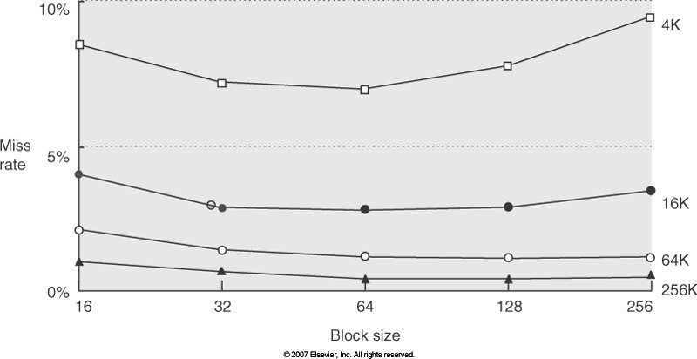
Reducing Miss Rate: Increasing block size
Competing Statements
  Want the block size large so don’t have to stop so often to load blocks
  Want the block size small so that blocks load quickly
  (i.e., reduce miss penalty)
Fig. B.10 SPEC92 on
DECstation 5000
Notes:
>>
Increasing cache block size improves spatial locality,
leading to fewer cache misses for sequential access patterns,
which reduces the frequency of block loading.
Larger blocks also enhance memory bandwidth efficiency
and can reduce the number of outstanding memory requests,
improving overall throughput.
(arrow down on each)
Competing statements:
We want to increase the block size to minimize the frequency of having to stop and load blocks.
However, larger blocks increase miss penalty if the entire block must be loaded before data is usable.
We want the block size small so that blocks load quickly
Smaller blocks reduce the time to load a block, minimizing miss penalty.
(arrow down)
(Go over diagram.)

Slide 8
Reducing Miss Rate: Increasing block size (cont.)
So, large block size may reduce miss rates, but …
Example:
  Suppose that loading a block takes 80 cycles (overhead) plus 2 clock cycles for each 16 bytes
  A block of size 64 bytes can be loaded in
80 + 2 * 64 / 16 cycles = 88 cycles (miss penalty)
Assume hit time is 1. If the miss rate is 7%, then the average memory access time is
AMAT = 1 + 0.07 * 88 = 7.16 cycles
Notes:
>>
So large block size may reduce miss rates but increase the miss penalty.
(Go over example.)

Slide 9
Reducing Miss Rate: Higher Associativity
A direct-mapped cache of size N has about the same miss rate as a 2-way set-associative cache of size N / 2
  2:1 cache rule of thumb
  (seems to work up to 128KB caches)
But associative cache is slower than direct-mapped.
So, the clock may need to run slower.

Slide 10
Reducing Miss Rate: Higher Associativity (cont.)
Example:
  Suppose that the clock for 2-way cache needs to run at a factor of 1.1 times the clock for 1-way cache
  (i.e., the longer hit time with higher associativity)
  Assume miss penalty is 50 cycles and 3% miss rate
  Assume 1 cycle for cache hit
  Q1. What is the average memory access time for direct-mapped? (assume 6% miss rate for direct-mapped)
  » AMAT = 1 + 0.06 * 50 = 4 cycles
  Q2. What is the average memory access time for 2-way?
» AMAT = 1 + 0.03 * 50 = 2.5 cycles
» But CCT (clock cycle time) is longer.
So, it corresponds to 2.75 cycles in 1-way design.
Notes:
>>
(Go over example.)

Slide 11
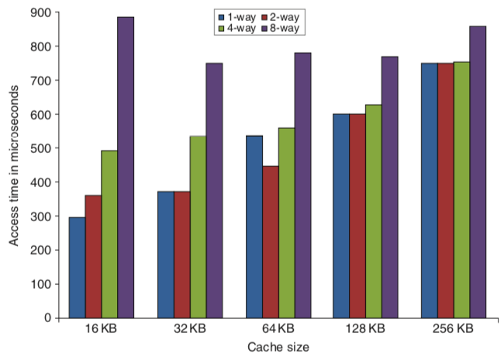
Cache size / associativity and Access times
Access times generally increase as cache size and associativity are increased
(Fig 2.3 H&P 6th)
Notes:
(H&P 6ed, Figure 2.3, page 77)
>>
Access times generally increase as cache size and associativity are increased
due to the added hardware complexity
interconnect delays
and longer critical paths for tag comparison and data retrieval.
Larger caches require more time to index and search,
while higher associativity necessitates more tag comparators and multiplexers,
which contribute to longer access times.
This trade-off is evident in the design of cache hierarchies,
where increased associativity reduces conflict misses
but at the cost of higher latency.

Slide 12
Reducing Miss Penalty: Multi-level Cache
For example, if cache access takes 1 clock cycle, and memory takes 50, might be a good idea to add a larger (but necessarily slower) secondary cache in between, perhaps capable of 10 clock cycle access
Complicates performance analysis, but 2nd level cache captures many of 1st level cache misses, lowering effective miss penalty
  And 3rd level cache has same benefits for 2nd level cache
Most modern machines have separate 1st and 2nd level instruction and data caches, shared 3rd level cache
  Previously shared 2nd level, and off processor chip shared 3rd level cache
Notes:
>>
(Reiterate)
Multilevel caches are a primary technique used to reduce the miss penalty in cache hierarchies
by introducing additional levels of cache between the CPU and main memory.
For example …

Slide 13
Victim Caches
A cache block that has recently been replaced (evicted)
  Uses a small, fully associative cache between a cache and where it gets data from
  Check the victim cache on a cache miss, before going to next lower-level memory
If found, swap victim block and cache block
  Reduces conflict misses
  Different to write buffer (sometimes, called victim buffer)
  to reduce the miss penalty
Notes:
>>
A cache block that has recently been replaced (evicted)
is stored in a small, fully associative cache
known as a victim cache.
This victim cache is used to hold blocks evicted from a higher-level cache,
and when a cache miss occurs, is checked before accessing the next lower-level memory.
(arrow down)
If the desired data is found in the victim cache,
swap the victim block with the block in the cache that was replaced during the miss.
The purpose of this mechanism is to reduce conflict misses
by providing a temporary storage for recently evicted data,
thereby improving overall cache performance.

Slide 14
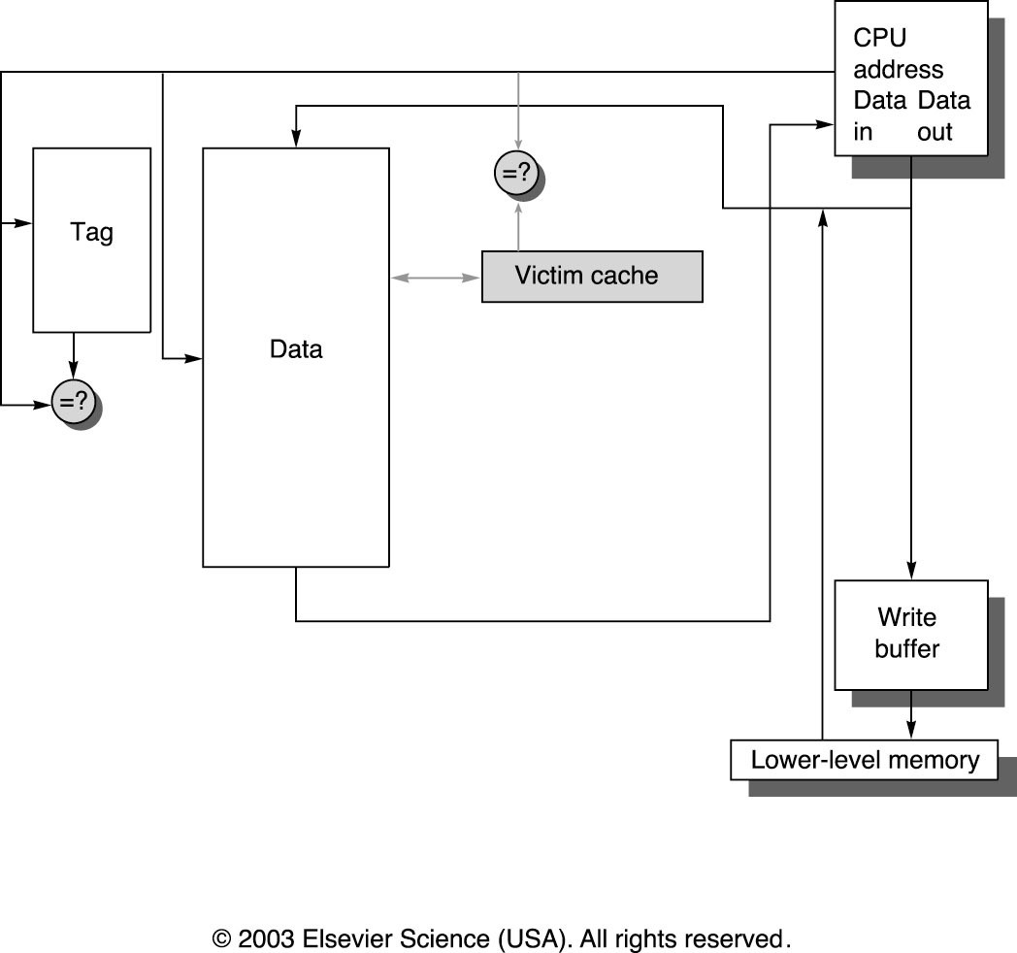
Victim Caches (cont.)
Figure from H&P 3ed
Notes:
(H&P 3ed, Figure 5.13, page 407)
>>
This diagram illustrates the placement of victim cache in the memory hierarchy.
Although it reduces miss penalty,
the victim cache is aimed at reducing the damage done by conflict misses.
Optional:
Jouppi [1990] found the four-entry victim cache could reduce the miss penalty for 20% to 95% of conflict misses.

Slide 15
Don't wait for the whole block on cache miss
Two ways to do this –
suppose need the 10th word in a block:
  Early restart: access the required word as soon as it is fetched, instead of waiting for the whole block
  Critical word first: start the fetch with word 10, and fill in the first few later
Notes:
>>
When a cache miss occurs and the CPU needs a specific word,
(such as the 10th word in a block,)
techniques like Early Restart and Critical Word First allow the CPU to proceed
without waiting for the entire block to be loaded.
(arrow down)
Early Restart involves fetching the block words in normal order from memory,
but as soon as the requested word arrives,
(such as the 10th word in a block,)
it is sent to the CPU to resume execution while the rest of the block continues to be fetched.
This reduces the effective miss penalty
by enabling the CPU to continue processing as soon as the needed data is available.
(arrow down)
Critical Word First involves requesting the specific word needed
(e.g., the 10th word in a block) first from memory
and sent to the processor immediately upon arrival,
allowing execution to continue while the rest of the block is filled in sequentially
This approach minimizes the effective miss penalty
by prioritizing the critical word.

Slide 16
Use a non-blocking cache
A “hit-under-miss” optimization
With this optimization, the cache doesn't stop for a miss, but continues to process later requests, if possible, even though an earlier one is not yet fulfilled
  Introduces significant complexity into cache architecture – must allow multiple outstanding cache requests
  (maybe even multiple misses)
  But this is what’s done in modern processors
Should L2 support this?
  In general, processors can hide L1 miss penalty but not L2 miss penalty
Notes:
>>
A non-blocking cache
allows the processor to continue executing instructions even during a cache miss.
This is achieved through the "hit-under-miss" optimization,
where the cache continues to service subsequent cache hits
while a previous miss is still being processed.
This approach reduces the effective miss penalty
by overlapping the processing of multiple memory requests,
enabling the CPU to proceed with other work instead of stalling.
(arrow down)
Disadvantage:
However, introducing a non-blocking cache significantly increases cache architecture complexity because
it must manage multiple outstanding cache requests simultaneously,
including the possibility of multiple misses occurring at once.
(arrow down)
Q. Should L2 caches also support this feature?
(arrow down)
A.
In general,
L2 caches typically have much higher latency due to their larger size and greater distance from the processor core,
making it impractical to hide their miss penalties through the same mechanisms.

Slide 17
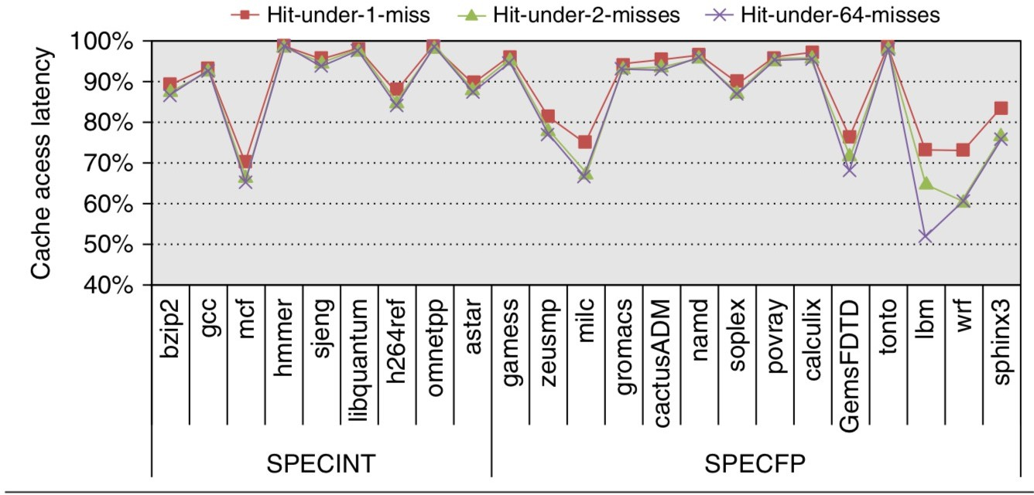
Use a non-blocking cache (cont.)
Fig 2.5 6th
Results with the data memory modeled after the Intel i7
32KB L1 cache with a four cycle access latency.
256KB L2 with 10 cycle access latency
2MB L3 with 36 cycle access latency
8-way set associative / 64B block size
Notes:
(H&P 6ed, Figure 2.5, page 84)
>>
This chart illustrates
the evaluation on the effectiveness of a nonblocking cache
by allowing 1, 2, or 64 hits under a cache miss
with 9 SPECINT (on the left) and 9 SPECFP (on the right) benchmarks.
The data memory system modeled after the Intel i7 consists of a
32KB L1 cache: with a four cycle access latency
256 KB L2 cache (shared with instructions): with a 10 clock cycle access latency
and a 2 MB L3 cache: with a 36-cycle access latency
All the caches are 8-way set associative and have a 64-byte block size.
Allowing a 1 hit under miss reduces the miss penalty by 9%
for the integer benchmarks and 12.5% for the floating point.
Allowing a 2 hits under miss improves these results to 10% and 16%.
And allowing 64 hits under miss results in little additional improvement.

Slide 18
Hardware Prefetching
Idea: If read page k, the next page read is likely page k+1
So, when a block is read from memory, read the next block too
  Maybe into a separate buffer that is accessed on a cache miss before going to memory
Advantage:
  If block access is sequential,
  will need to fetch only half (or more) as often from memory
Disadvantages:
  More data to move
  May fill the cache with useless blocks
  May compete with demand misses for memory bandwidth
Notes:
>>
Hardware prefetching is a technique
where the CPU predicts and fetches data into cache
before it is explicitly requested, to hide memory latency.
The core idea is that:
If a block from page k is accessed,
the next access is likely to be from page k+1
(especially in sequential access patterns)
(arrow down)
So, when a cache miss occurs,
and the missed block is read from memory,
a hardware prefetcher will initiate a prefetch of the subsequent block
(often using a separate buffer to hold prefetched data)
…

Slide 19
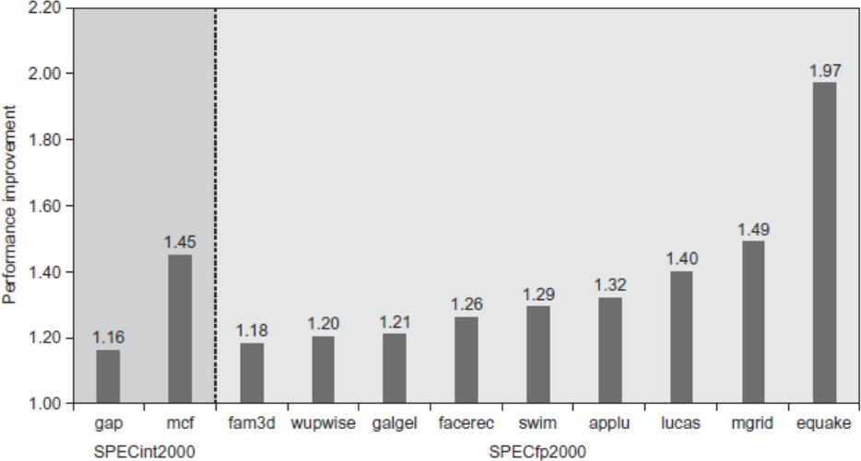
Hardware Prefetching (cont.)
Notes:
(H&P 5ed, Figure 2.10, page 92)
>>
This chart shows the
speedup due to hardware prefetching on Intel Pentium 4 with hardware prefetching
turned on for 2 of 12 SPECint2000 benchmarks and 9 of 14 SPECfp2000 benchmarks.
Only the programs that benefit the most from prefetching are shown;
prefetching speeds up the missing 15 SPEC benchmarks by less than 15% [Singhal 2004].

Slide 20
Compiler-Controlled Prefetching
Idea: The compiler has a better idea than the hardware does of when blocks are being use sequentially
Some CPUs include prefetching instructions in its ISA
  Insert prefetch instructions before data is needed
  e.g., vprefetch1 (to L2) / vprefetch0 (to L1) on Intel Xeon Phi
Of course, prefetching does not help if it interferes with normal CPU memory access or operation.
  Thus, the cache must be nonblocking (also called lockup-free).
  don't slow the pipeline waiting for it
Usually want the prefetch to fail quietly:
  If ask for an illegal block (one that generates a page fault or protection exception), don't generate an exception; just continue as if the fetch wasn't requested
  called a non-binding cache prefetch
Notes:
>>
The core idea behind Compiler-controlled prefetching is
the compiler has a better idea than the hardware does of when blocks are being use sequentially.
It works by leveraging the compiler's static analysis
to predict data access patterns more accurately than hardware alone
(particularly for sequential block usage)
(arrow down)
Modern CPUs include prefetching instructions in their ISA,
which enables the insertion of prefetch instructions before data is required
to hide memory latency.
(arrow down)
However,
prefetching is ineffective if it interferes with normal CPU memory operations,
Therefore, the use of a nonblocking (lockup-free) cache is necessary.
(arrow down)
When a prefetch request involves an invalid address (illegal block),
(such as one that would generate a page fault or protection exception)
the prefetch instruction does not generate a hardware exception
Instead, it fails silently and the program continues execution as if the prefetch request had not been issued.

Slide 21
How to reduce the time for cache hits?
K.I.S.S. (Keep It Simple, Stupid)
Use virtual addresses rather than physical addresses in the cache.
Pipeline cache accesses
Trace caches
Notes:
For reference:
A trace cache is
a specialized instruction cache that stores sequences of instructions,
known as traces,
in their dynamic execution order rather than their static memory layout.

Slide 22
K.I.S.S. (Keep It Simple, Stupid)
Cache should be small enough to fit on the processor chip
Direct mapped is faster than associative
  Especially on
    read and scheduling of instructions
    use of L2 and L3 caches
    (to avoid main memory accesses)
Overlap tag check with transmitting data
For current processors,
relatively small L1 caches to keep fast clock cycle time,
hide L1 misses with dynamic scheduling
Notes:
>>
To reduce the time for cache hits,
keep the cache design simple and small,
as this minimizes the critical path through the hardware and speeds up hit detection.
(arrow down)
Additionally, employing a low associativity (e.g., direct-mapped) cache
simplifies the tag comparison logic, further decreasing hit time.
For instruction scheduling,
leveraging L2 and L3 caches can improve performance
by handling misses from L1.
(arrow down)
…

Slide 23
Use Virtual addresses instead of Physical addresses
Each process has its own address space, and no addresses outside that space can be accessed
To keep address length small, each user addresses by offsets relative to some physical address in memory (pages)
For example,
– Assuming that the page address 5000
Physical address | Virtual address
0x5000 | 0x0000
0x5012 | 0x0012
0x5100 | 0x0100
Notes:
>>
Reducing cache hit time can be achieved
by using virtual addresses for indexing,
which avoids the need for address translation
during the cache access process
(See overlap access on VM slides for more details.)
…
(arrow down)
For example:
Page size: 4KB (2^12 bytes)
Page offset: 12-bits
Virtual page number 0 maps to Physical frame number 5
Page offset 0x000 (from 0x00) is added to the start of the frame:
(0x5 << 12) + 0x000 = 0x5000
Optional:
(Using a virtually addressed cache avoids the need for address translation during indexing, which can reduce hit time.)

Slide 24
Virtual Addresses (cont.)
Since instructions use virtual addresses, use them for index and tag in cache, to save the time of translating to physical address space
Note that the cache will be flushed, setting all blocks to invalid when switched to a new user in the OS (a context switch) if virtual addresses are used for cache access, since the same virtual address then may refer to a different physical address
  Or use the process / user ID as part of the tag in cache
Aliases are another problem
  When two different virtual addresses map to the same physical address – can get 2 copies in cache
» What happens when one copy is modified?
Notes:
>>
Since instructions can use virtual addresses for both indexing and tagging in a cache,
time can be saved by allowing the cache lookup to begin before address translation is complete.
…
Q. What happens when one copy is modified?
A.
If one copy is modified,
the other copy remains unchanged,
leading to data inconsistency and potential corruption,
as the update is not reflected in the other cache entry.

Slide 25
Pipelined Cache Access
Benefit
  Fast clock cycle time
Penalty
  Slower hits (increased latency)
  More clock cycles between a load and the use of the data (maybe more pipeline stalls)
Examples
  Intel Pentium (mid-1990s) : 1 cycle for cache access
  Pro ~ Pentium III (~2000): 2 cycles
  Pentium 4 ~ Core i7: 4 cycles
All modern processors use pipelining for L1 cache
Notes:
>>
Pipelined cache access
allows for faster clock cycle times by breaking the cache access into multiple stages,
enabling a new access to begin each cycle even if previous accesses are still in progress.
However, this comes at the cost of increased hit latency,
as a L1 cache hit now spans multiple clock cycles
instead of being completed in a single cycle.
And results in more clock cycles between
a load instruction and the availability of its data,
potentially increasing the number of pipeline stalls.
Examples: … (# of cycles grows over time)
All modern processors use pipelined cache access for L1 cache
(where the access latency is typically 4-7 cycles
depending on the processor and data type)

Slide 26
Multi-banked cache
Multiple memory reference instructions may be issued per cycle in superscalar processors
  Need to access cache simultaneously
Divide cache into multiple banks and make each support an independent access
  Intel Core i7 has 4 banks in L1
Specific addresses will be mapped to specific banks
  e.g., Modulo (sequential interleaving)
Multiple banks in L2?
  Will be able to handle multiple outstanding L1 misses
Notes:
>>
A multi-bank cache design can help overcome the limitations of pipeline cache access.
In a single bank cache layout,
only one memory access per cycle is allowed,
limiting its ability to handle multiple concurrent memory requests,
(which can become a bottleneck in high-performance processors.)
A multi-bank cache
is designed to support multiple memory reference instructions per cycle
(in superscalar processors)
by dividing the cache into several independent banks,
each capable of handling separate accesses simultaneously.
Example: Intel Core i7 has 4 banks in L1
(arrow down)
Specific addresses are mapped to specific banks (via sequential interleaving),
where the bank number is determined by the block address modulo the number of banks
(arrow down)
Q. What about multiple banks in L2?
(arrow down)
A.
The use of multiple banks in L2
Will enable the system to handle multiple outstanding L1 misses effectively.
(as long as the misses are directed to different banks)

Slide 27
Reads are easy, Writes are not
Most memory accesses are reads, not writes, because read happens for both data and instructions but write happens only for data
Make most reads from cache fast:
  Again… overlap operations needed! Just pull the data from cache into a register as soon as it is accessed, while checking whether the address matches the tag. If it were a cache miss, load a block from lower-level memory to cache, then into the register again.
Can’t do this with write:
  must verify the address before changing the value of the cache location
Notes:
...
(arrow down)
To make reads fast, modern systems rely heavily on caching.
When a read request is made, the system checks the cache first.
If the data is found in the cache (a cache hit),
it can be pulled directly into a register
as soon as the address matches the tag
If a cache miss occurs,
data must be loaded from lower-level memory into cache,
then again into a register.
(arrow down)
However, write operations are more complex
because they require ensuring data consistency.
A write must verify the address before modifying the cache.
(especially when using write-back policies
where the cache line is marked as "dirty"
and must eventually be written back to main memory.)

Slide 28

Write Buffers for Write-Through Caches
Processor
Cache
Lower Level Memory
Write Buffer
Holds (addresses & data) awaiting write-through to lower-level memory
Q. Why a write buffer ?
Q. Why a buffer, why not just one register ?
Q. Are Read After Write (RAW) hazards an issue for write buffer?
A. So CPU doesn’t stall
A. Bursts of writes are common.
A. Yes! Drain buffer before next read, or send read 1st after check write buffers.
Notes:
>>
A write buffer in a write-through cache
acts as an intermediary between the cache and main memory,
storing data awaiting write to the next level of the memory hierarchy.
In a write-through L1 cache,
a write buffer serves to absorb processor writes at a rate faster than the next-level cache can handle,
preventing processor stalls.
Its primary purpose is to aggregate multiple writes targeting the same cache block,
combining consecutive writes into a single buffer entry.
(Go over Q. & A.)
…
(arrow down)
Q. Are Read After Write (RAW) hazards an issue for write buffer?
(arrow down)
A. Yes! To handle this, two primary strategies exist:
Either drain the entire write buffer before servicing a read miss (can degrade performance)
Or check the write buffer contents after checking the cache before proceeding with a read miss

Slide 29
Another Write Buffer Optimization
Write buffer mechanics, with merging
  An entry may contain multiple words
  (maybe even a whole cache block)
  If there’s an empty entry, the data and address are written to the buffer, and the CPU is done with the write
  If buffer contains other modified blocks, check to see if new address matches one already in the buffer – if so, combine the new data with that entry (Write merging in Intel Core i7)
  If buffer full and no address match, cache and CPU wait for an empty entry to appear (meaning some entry has been written to main memory)
  Merging improves memory efficiency, since multi-word writes usually faster than one word at a time
Notes:
…
(arrow down)
If there’s an empty entry,
the data and address are written to the buffer,
(and the CPU is done with the write.)
(arrow down)
If buffer contains other modified blocks,
check to see if new address matches one already in the buffer.
If so, combine the new data with that entry.
(arrow down)
If buffer full and no address match,
the cache and CPU must stall until an entry becomes available
after data is written back to main memory.
…

Slide 30
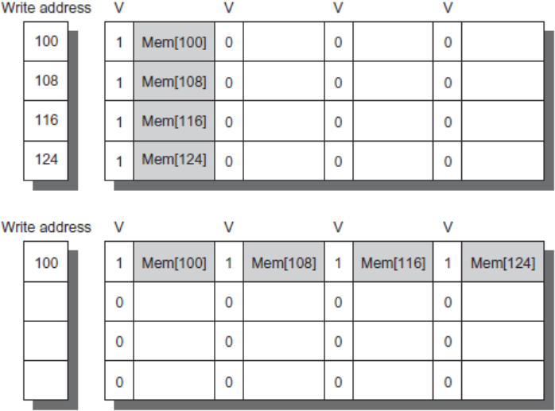
Write Buffer Optimization
No write merging
With write merging
Notes:
(H&P 6ed, Figure 2.7, page 88)
>>
In this figure,
the write buffer on top does not use write merging
while the write buffer on the bottom does.
The buffer has four entries,
and each entry holds four 64-bit words.
The address for each entry is on the left,
with a valid bit (V) indicating whether the
next sequential 8 bytes in this entry are occupied.
Four 64-bit (8 byte) writes can be merged into a single buffer entry with write merging.
Without write merging,
the buffer is full even though 3/4 of each entry is wasted.

Slide 31
FURTHER COMPILER OPTIMIZATIONS TO
REDUCE CACHE MISS RATE

Slide 32
Three Compiler Techniques
3 techniques to improve cache locality:
  Merging arrays
  Loop interchange
  Loop fusion

Slide 33
Technique 1: Merging Arrays
Suppose have two arrays:
  int val[size];
  int key[size];
And that usually use both of them together
Notes:
>>
The first compiler optimization technique is merging arrays.
Merging arrays improves spatial locality
by combining two separate arrays into a single array of structures,
ensuring that related data elements are accessed together
(and reducing cache misses).
…

Slide 34
Technique 1: Merging Arrays (cont.)
Assume they would be stored as follows and the cache block size is 64 words:
val[0]
val[1]
val[2]
val[3]
.
.
.
val[64] val[65] val[66] val[67]
.
.
.
.
.
val[size-1]
key[0]
key[1]
key[2]
key[3]
.
.
Notes:
>>
Assume:
the cache block size is 64 words
and the arrays would be stored as follows.
First block stores
val[0] through val[63]
Second block stores
val[64 through val[127]
And so on until val[size-1] is reached
Followed by the elements of key …

Slide 35
Technique 1: Merging Arrays (cont.)
Means that at least 2 blocks must be in cache to begin using the arrays.
val[0]
val[1]
val[2]
val[3]
.
.
.
val[64] val[65] val[66] val[67]
.
.
.
.
.
val[size-1]
key[0]
key[1]
key[2]
key[3]
.
.
Notes:
>>
This means that at least 2 blocks must be in cache to begin using the arrays.

Slide 36


Technique 1: Merging Arrays (cont.)
More efficient, especially if more than two arrays are coupled this way, to store them together.
int val[SIZE];
.
.
.
val[0]
key[0]
val[1]
key[1]
.
.
.
val[32] key[32] val[33] key[33]
.
.
.
int key[SIZE];
struct merged_data {
int val; int key;
};
struct merged_data array[SIZE];
Notes:
>>
However, if we merge the arrays,
then only one block needs to be in cache begin use.
This is more efficient,
especially if more than two arrays are coupled this way.

Slide 37
Technique 2: Interchanging Loops
Example:
For j=0, 1, …, 99
 |  | For i=0, 1, …, 4999
 |  |  | x[i][j] = 2 * x[i][j];
 |  | End for;
 | End for;
Notes:
>>
The second compiler optimization technique is loop interchange.
Loop interchange
is the reordering nested loops
so that data can be accessed in the same sequence as it is stored in memory.
(minimizing striding and enhancing spatial locality by enabling sequential memory access.)
(Go over the example.)

Slide 38
Technique 2: Interchanging Loops
Notice that accesses are by columns, so the elements are spaced 100 words apart.
Blocks are bouncing in and out of cache.
Example:
For j=0, 1, …, 99
 |  | For i=0, 1, …, 4999
 |  |  | x[i][j] = 2 * x[i][j];
 |  | End for;
 | End for;
Notes:
>>
Notice that accesses are by columns,
This means the elements are spaced 100 words apart,
which is larger than the cache block size.
This access pattern, characterized by striding across multiple cache blocks,
can lead to frequent cache misses due to poor spatial and temporal locality.
Optional:
In direct-mapped or low-associativity caches,
such striding can cause multiple memory blocks to map to the same cache set,
leading to repeated evictions and reloads of cache lines
a phenomenon known as cache thrashing.

Slide 39
Technique 2: Interchanging Loops
First, color the loops:
For j=0, 1, …, 99
 |  | For i=0, 1, …, 4999
 |  |  | x[i][j] = 2 * x[i][j];
 |  | End for;
 | End for;

Slide 40
Technique 2: Interchanging Loops
Notice that the program has the same effect if the two loops are interchanged:
For i=0, 1, …, 4999
For j=0, 1, …, 99
x[i][j] = 2 * x[i][j];
End for;
End for;

Slide 41
Technique 2: Interchanging Loops
But with this ordering, use every element in a cache block before needing another block!
For i=0, 1, …, 4999
For j=0, 1, …, 99
x[i][j] = 2 * x[i][j];
End for;
End for;
Notes:
>>
This reordering allows every element in a cache block to be used before needing another block!

Slide 42
Technique 3: Loop Fusion
For j=0, 1, …, 99
 |  | For i=0, 1, …, 4999
 |  |  | x[i][j] = 2 * x[i][j];
 |  | End for;
 | End for;
Example:
For j=0, 1, …, 99
 |  | For i=0, 1, …, 4999
 |  |  | y[i][j] = x[i][j] * a[i][j];
 |  | End for;
 | End for;
Notes:
>>
The third compiler optimization technique is loop fusion.
Loop fusion combines multiple independent loops that operate on the same data,
(increasing temporal locality by bringing data accesses closer together
and allowing for more reuse within the cache.)

Slide 43
Technique 3: Loop Fusion (cont.)
For j=0, 1, …, 99
 |  | For i=0, 1, …, 4999
 |  |  | x[i][j] = 2 * x[i][j];
 |  | End for;
 | End for;
Note that the loop control
is the same for both sets of loops.
For j=0, 1, …, 99
 |  | For i=0, 1, …, 4999
 |  |  | y[i][j] = x[i][j] * a[i][j];
 |  | End for;
 | End for;

Slide 44
Technique 3: Loop Fusion (cont.)
For j=0, 1, …, 99
 |  | For i=0, 1, …, 4999
 |  |  | x[i][j] = 2 * x[i][j];
 |  | End for;
 | End for;
And note that the array x is used in each, so probably needs to be loaded into cache twice, which wastes cycles.
For j=0, 1, …, 99
 |  | For i=0, 1, …, 4999
 |  |  | y[i][j] = x[i][j] * a[i][j];
 |  | End for;
 | End for;
Notes:
>>
And note that the array x is used in each loop,
but may need to be loaded into cache twice.

Slide 45
Technique 3: Loop Fusion (cont.)
For j=0, 1, …, 99
 |  | For i=0, 1, …, 4999
 |  |  | x[i][j] = 2 * x[i][j];
 |  |  | y[i][j] = x[i][j] * a[i][j];
 |  | End for;
 | End for;
So, combine, or fuse, the loops to improve efficiency.

Slide 46
Multi-Level Inclusion…
If all data in level n is also in level n+1
  Each bigger part of the memory hierarchy contains all data (addresses) in smaller parts
  Not always the same data because of delayed write-back
Why useful?
Notes:
>>
In a multi-level cache hierarchy,
if all data in a lower level (level n)
is also present in the higher level (level n+1),
this is known as an inclusive cache policy.
…
(arrow down)
Q. Why is this useful?
A. It simplifies cache coherence in multiprocessor systems.

Slide 47
So Far…
Direct-mapped, set-associative, fully associative cache
Write-through and write-back cache
Cache optimizations to reduce memory stalls
  Reduce miss rate
  Reduce miss penalty
  Reduce hit time
Reduce miss rate
  Increase block size, higher associativity, victim cache, prefetching
Reduce miss penalty
  Multi-level cache, give priority to read over write miss, don’t wait for the whole block, use a non-blocking cache, merging arrays
Reduce hit time
  K.I.S.S., virtual cache, pipelined cache, trace cache

Slide 48
Summary - Caches
The Principle of Locality:
  Program access a relatively small portion of the address space at any instant of time.
» Temporal / Spatial Locality: Locality in Time and Space
Three Major Uniprocessor Categories of Cache Misses:
  Compulsory Misses: sad facts of life. Example: cold start misses.
  Capacity Misses: increase cache size
  Conflict Misses: increase cache size and/or associativity.
  Coherence Misses (in multiprocessors): Avoid frequent use of shared variables in parallel programs.
Write Policy: Write Through vs. Write Back
Write-Miss Policy: Write-Allocate vs. Write-No-Allocate

Slide 49
Summary - The Cache Design Space
Several interacting dimensions
  cache size
  block size
  associativity
  replacement policy
  write-through vs. write-back
  write allocation
The optimal choice is a compromise
  depends on access characteristics
» workload
» use (I-cache, D-cache, TLB)
  depends on technology / cost
Cache Size
Associativity
Block Size
Bad
Good
Factor A
Factor B
Less
More
Simplicity often wins

